Slide 1
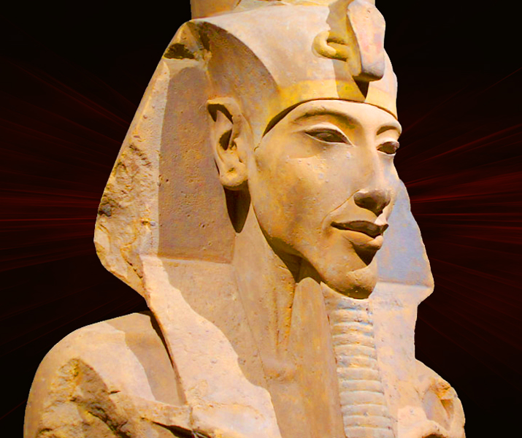
REVIEW – Amenhotep IV
GOAL/S: Review Amenhotep’s Path to Power
Week 1, Lesson 1

Slide 2
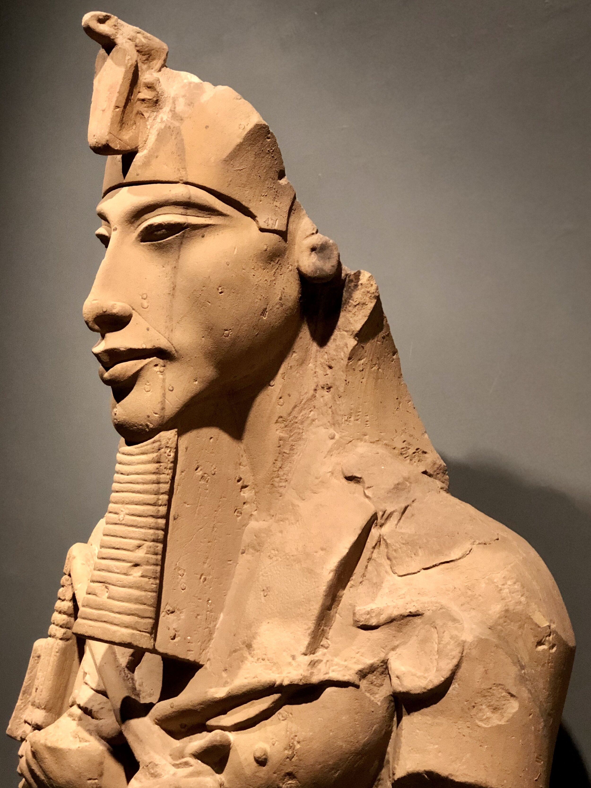
Akhenaten was a pharaoh who ruled over Egypt during the 18th Dynasty and sparked one of history's most fascinating religious revolutions. He ascended the throne amidst Egypt's golden age, but triggered a period of turmoil in Egypt's religious traditions by promoting the worship of Aten, the sun disk. In his fifth year of rule, he abandoned traditional gods, built a new capital city, and even radical transforming Egyptian society. But such dramatic changes in such a short time would lead to the destruction of his dreams very soon after his death.

Slide 3
What have we covered so far?
Term/Week | Topic/Content | Assessments
T2 – 8 - 9 | Eyptian Society Overview
T2 – 10 - 11 | Years 1 – 4: Amenhotep IV | Week 11 – Essay (15%)
TERM BREAK (Holidays)
T3 – 1 - 2 | Years 5 – 8
T3 – 3 - 5 | Years 9 – 11 | Week 5 – Source Analysis (15%)
T3 – 6 - 8 | Years 12 - 17 | Week 6 – 8 – Inquiry (10%)
T3 – 9 – 10 | Death of Akhenaten and rule of Tutankhamun | Week 10 – Test (15%)

Slide 4
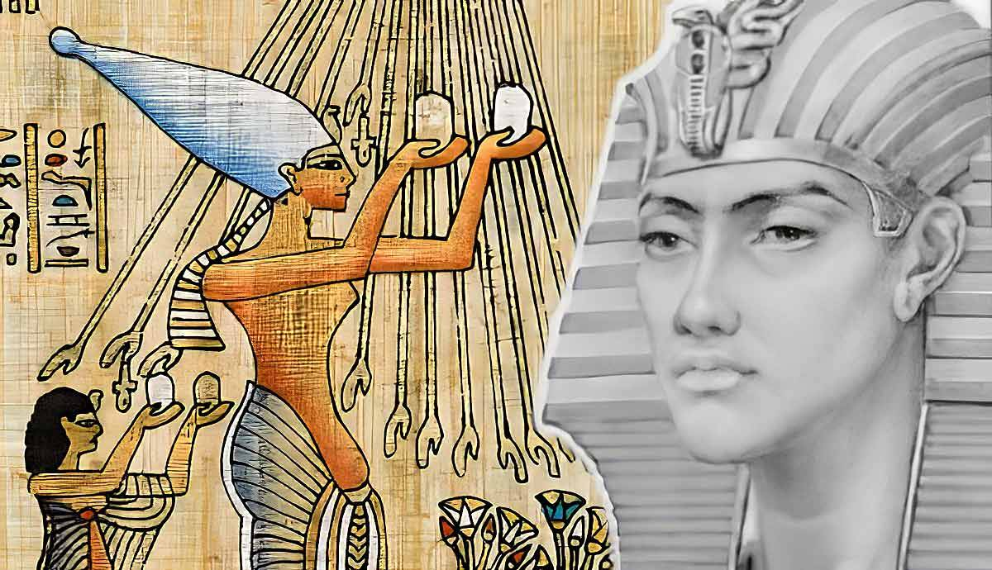
REVIEW – Amenhotep IV
Born Amenhotep IV, Akhenaten was the tenth ruler of the 18th Dynasty.
Known for his radical religious reforms.
Married to Nefertiti, father of Tutankhamun.
Son of Amenhotep III and Queen Tiye.
Ascended to the throne around 1353 BCE.
Initially followed traditional religious practices.

Slide 5
REVIEW – Egypt Historical Context
Egypt was a polytheistic society, worshipping many gods.
The Amun priesthood held significant power and wealth.
Akhenaten’s father, Amenhotep III, promoted the worship of the sun god Aten.
Akhenaten's early reign was marked by adherence to traditional practices.
The political and religious landscape set the stage for his later reforms.
Understanding this background is crucial for studying his subsequent changes.

Slide 6
Watch the following
https://www.youtube.com/watch?v=wKSqgLQNIeQ&ab_channel=ExtraHistory

Slide 7
ACTIVITY - Timeline
Feedback from Term 2 – limited dates provided, unclear events
INSTRUCTIONS:
Using the dates and template provided, create a timeline of events of Amenhotep IV’s/Akhenaten’s rule
This is organised into ‘Years of Rule’
Must be completed and submitted by the end of the lesson

